Slide 1


GS for a “Killer” doing PRELIMS-CUM-MAINS Prep.
GSM1,2,3
GSM1,2,3
GSM1,3
GSM1, 2, 3
GSM1,2
Economy
Science Tech
Current
History
Geography
Polity
Agriculture
Environment
Culture
IR/Defense
GSM1
GSM 2,3
GSM 1, 2, 3
Notes:
Killing is as easy as breathing.

Slide 2
General Studies: History & Culture
Ancient-Medieval
LucentGK
Freedom Struggle
Spectrum (Rajiv Ahir)
LucentGK
Later for Mains
World History
India since independence
TN
TN (entry of Euro)
Bipan Chandra
Culture
NIOS, New NCERT
Ishani Pandya (Youtube)
New NCERT
If time permits: (1) Sumit Sarkar (2) Plassey to Partition
Notes:
NCERT Class11

Slide 3
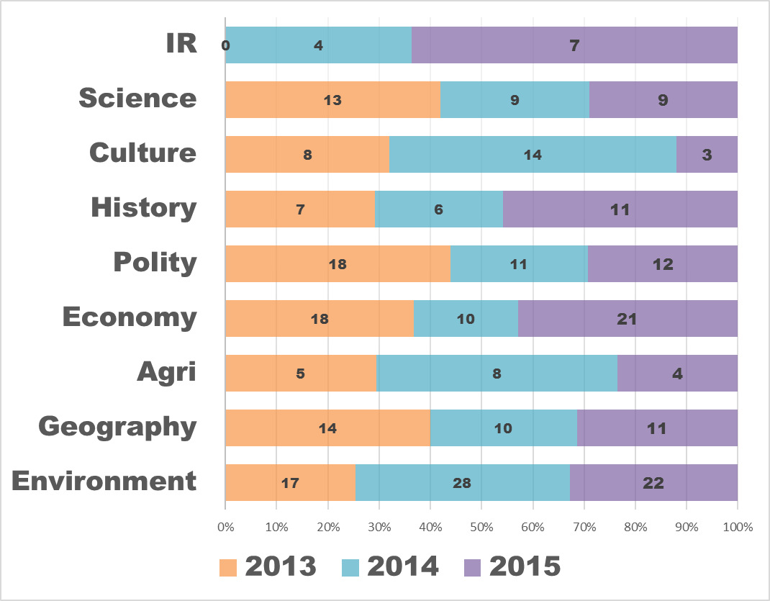
Brief analysis of last 3 Prelim papers
preCSAT: PIN
Sports, PIN Easy to moderate
Pinch higher than NCERT
Lunacy gone. 2/3 solvable.
Freedom struggle getting bit tougher
Medieval making comeback
No current. Mostly Laxmikanth
Easy to moderate
Crazy physical
Moderate to difficult but not IFoS-exclusive
Mostly map based, Moderate
Easy to moderate.
Nothing IFoS-exclusive

Slide 4
Why read NIOS?
CSE-2015
46. Kalamkari painting refers to
a hand-painted cotton textile in South India
a handmade drawing on bamboo handicrafts in North-East India
a block-painted woollen cloth in Western Himalayan region of India
a hand-painted decorative silk cloth in North-Western India

Slide 5
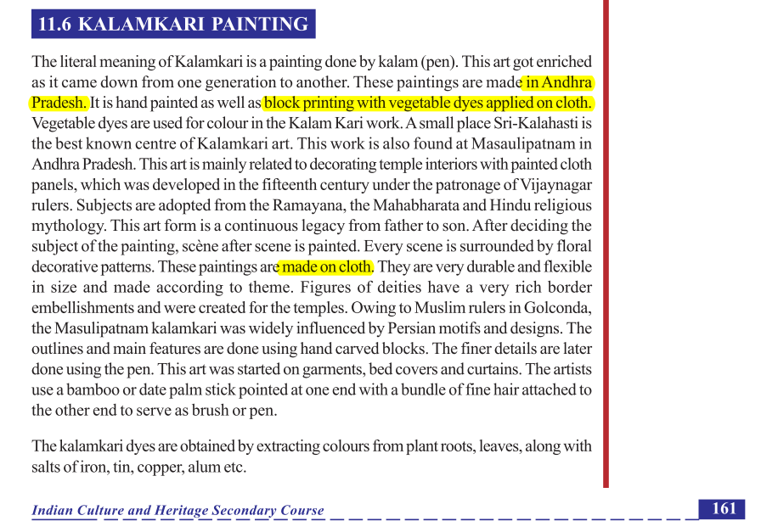
NIOS Culture PDF, Chapter 11 page 161

Slide 6
Why read NIOS?
CSE-2015
46. Kalamkari painting refers to
a hand-painted cotton textile in South India (NIOS Page 161)
a handmade drawing on bamboo handicrafts in North-East India
a block-painted woollen cloth in Western Himalayan region of India
a hand-painted decorative silk cloth in North-Western India

Slide 7
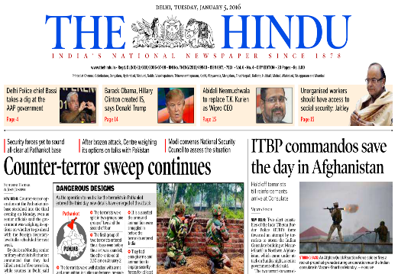
Why read the Hindu?
CSE-2015
25. Which one of the following was given classical language status recently?
(a) Odia
(b) Konkani
(c) Bhojpuri
(d) Assamese
TheHindu 2015, March

Slide 8
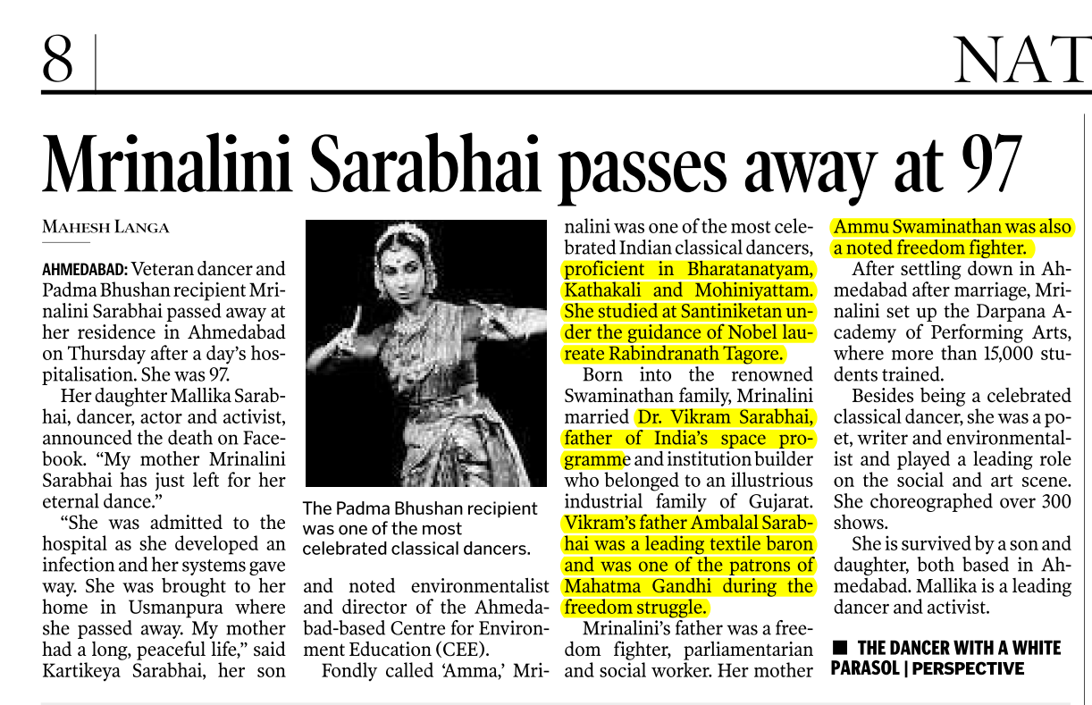


Slide 9
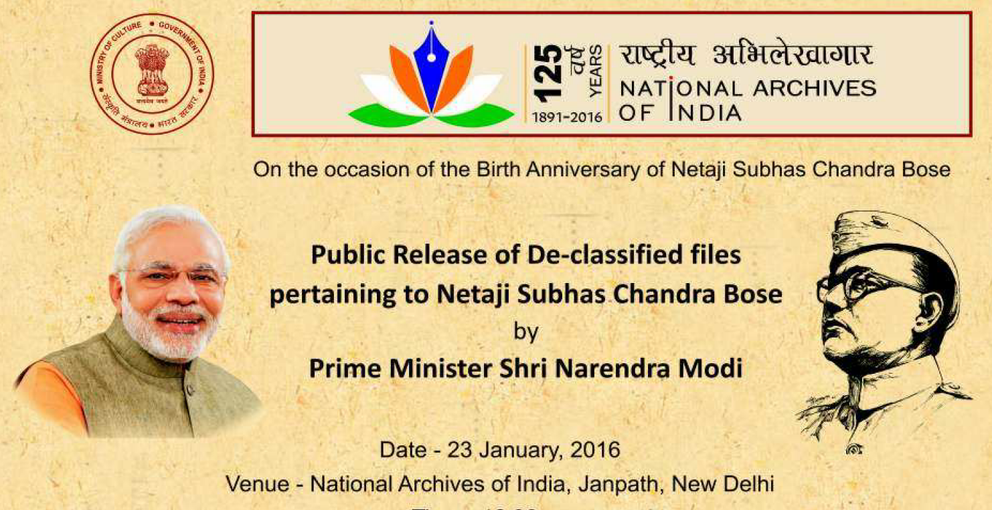
Under ministry of culture
Notes:
Match the following

Slide 10
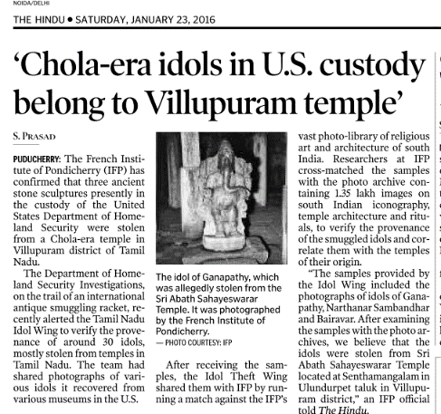
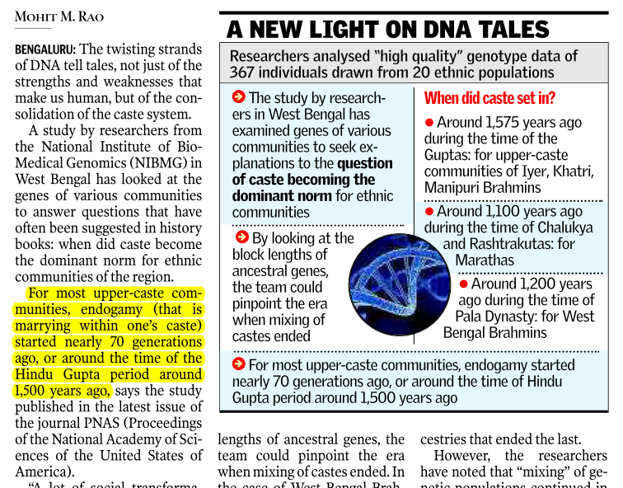



Slide 11
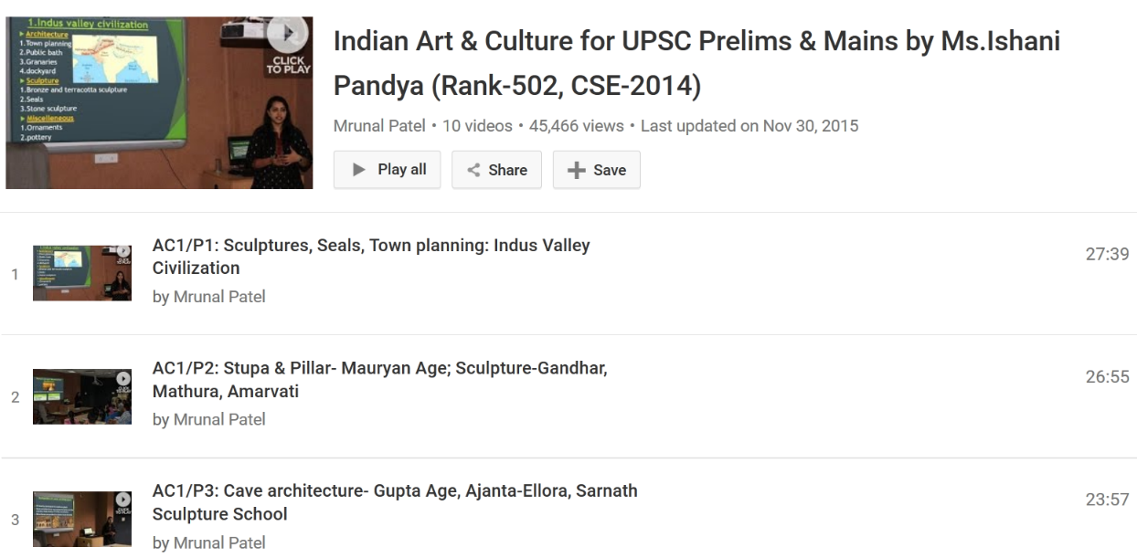

https://www.youtube.com/user/TheMrunalPatel
CCRTIndia
Wikipedia
covered within it

Slide 12
Culture
NIOS (PDF)
TheHindu
Ishani Pandya’s Lectures (Available on youtube)
CCRTIndia (covered by Ishani)
Spectrum Art & Culture (not asked)

Slide 13
Doesn’t mean you can solve every MCQ!
CSE-2015
4. Which one among the following was made earliest?
(a) Lingaraja Temple at Bhubneshwar
(b) Rock-cut Elephant at Dhauli
(c) Rock-cut Monuments at Mahabalipuram
(d) varaha Image at Udayagiri

Slide 14
Answer is “B”
A.Lingaraja | 12th AD https://books.google.co.in/books?id=fQB3Fkc3Tl4C&pg=PA168
B.Rock cut elephant | 3rd BC https://books.google.co.in/books?id=9ic4BjWFmNIC&pg=PA608
C.Rock cut monuments Mahabalipuram | 6th AD https://books.google.co.in/books?id=0O9je9dECH8C&pg=PA118
D.Varaha image | 5th AD https://books.google.co.in/books?id=bxPeWwFz9MkC&pg=PA200

Slide 15
General Studies: History & Culture
Ancient-Medieval
LucentGK
Freedom Struggle
Spectrum (Rajiv Ahir)
LucentGK
Later for Mains
World History
India since independence
TN
TN (entry of Euro)
Bipan
Culture
NIOS
Ishani Pandya (Youtube)
If time permits: (1) Sumit Sarkar (2) Plassey to Partition
Notes:
NCERT Class11

Slide 16
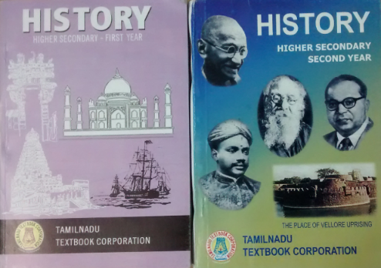
Tamilnadu Class 11 and 12 (Mrunal.org/download)
Ancient
Medieval
Freedom struggle
World History

Slide 17
Why read TN Class-11, 12?
CSE-2015
97. Who of the following founded a new city on the south bank of a tributary to river Krishna and undertook to rule his new kingdom as the agent of a deity to whom all the land south of the river Krishna was supposed to belong?
(a) Amoghavarsha I
(b) Ballala II
(c) Harihara I
(d) Prataparudra II
TN Clas11, History Page. 210
This is given in GS Manuals also, but presentation very cluttered

Slide 18
Why old NCERT cost:benefit less?
CSE-2015
The arrival of Babur into India led to the
1. introduction of gunpowder in the subcontinent
2. introduction of the arch and dome in the region's architecture
3. establishment of Timurid dynasty in the region
Select Answer (a) 1 and 2 only; (b) 3 only; (c) 1 and 3 only ; (d) 1, 2 and 3

Slide 19
Old NCERT Medieval (Satish Chandra ch.11,12)
CSE-2015
1st statement is wrong: Satish Chandra Chapter 12 page 206 an 210: Apparently gunpowder was known to India but its use for military became common in North India with the advent of Babur…His victories led to rapid popularization of gunpowder and artillery in India.
2nd statement is wrong, Chapter 11, Page 183-184: Arch and Domes were known to Indians earlier but they were not used on a large scale. The Turkish rulers (during Delhi Sultanate era before Babur) used both dome and arch methods as well slab and beam method in their buildings.

Slide 20
Why old NCERT cost:benefit less?
CSE-2015
The arrival of Babur into India led to the
1. introduction of gunpowder in the subcontinent
2. introduction of the arch and dome in the region's architecture
3. establishment of Timurid dynasty in the region
Select Answer (a) 1 and 2 only; (b) 3 only; (c) 1 and 3 only ; (d) 1, 2 and 3

Slide 21
Old NCERT
New NCERT (2007)
Geography (USSR)
Economy (academic)
Science (factual, cluttered)
History:
TN state Books
GS Manual
History (Art, culture, religion)
Geography
Economy (11, 12)
Science
Pol.Sci., Socio

Slide 22
Old NCERT available on online shopping sites
RS Sharma: India’s Ancient Past
Satish Chandra: History of Medieval India
Bipan Chandra: History of Modern India
Arjun Dev: History of the World
But Combined time and money cost is high.
Rarely anything asked that can’t be solved without old NCERT

Slide 23
General Studies: History & Culture
Ancient-Medieval
LucentGK
Freedom Struggle
Spectrum (Rajiv Ahir)
LucentGK
Later for Mains
World History
India since independence
TN
TN (entry of Euro)
Bipan
Culture
NIOS
Ishani Pandya (Youtube)
If time permits: (1) Sumit Sarkar (2) Plassey to Partition
Notes:
NCERT Class11

Slide 24
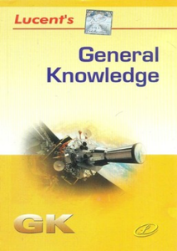

Why read LucentGK?
CSE-2015
Consider the following statements
The first woman President of the Indian National Congress was Sarojini Naidu.
The first Muslim President of the Indian National Congress was Badruddin Tyabji.
Both A and B
Neither A nor B
LucentGK page 133
Click to buy
English Edition
Hindi Edition

Slide 25
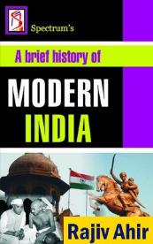
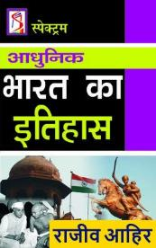
Why read spectrum?
CSE-2015
Name of economic critics of colonialism- Page 68
moderate vs extremist split was caused by ____ movement. Page89
3TF: cabinet mission pg. 230

Slide 26
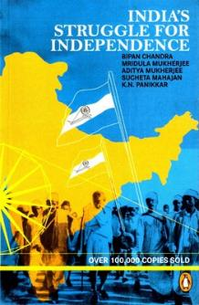
Why read Bipan Chandra?
CSE-2015
96. Who of the following organized a march on the Tanjore coast to break the Salt Law in April 1930?
(a) V. O. Chidambaram Pillai
(b) C. Rajagopalachari
(c) K. Kamaraj
(d) Annie Besant
Bipan Chandra Page 272:In Tamilnadu, C.Rajagopalachari, led a salt march from Trichinopoly to Vedaranniyam on the Tanjore coast.
Click to buy
Book Edition
Kindle Edition

Slide 27
Doesn’t mean you can always solve!!
CSE-2015
66. Rowlatt Satyagraha,
The Rowlatt Act was based on the recommendations of the 'Sedition Committee'.
In Rowlatt Satyagraha, Gandhiji tried to utilize the Home Rule League.
Demonstrations against the arrival of Simon Commission coincided with Rowlatt Satyagraha.
Correct statements are: (a) 1 only; (b) 1 and 2 only ; (c) 2 and 3 only ; (d) 1, 2 and 3

Slide 28
Spectrum + Bipan needed to solve single MCQ
CSE-2015
2nd statement is right: Spectrum page 125: Gandhi organized a Satyagraha sabha and roped in younger members of Home rule league and Pan Islamists. Therefore, A eliminated.
3rd statement is wrong: As per Bipan Chandra page 181 to 183: Rowlatt Satyagraha started in Feb 1919 and Gandhi stopped it in 18th April 1919 because of violence. A year later, he launched a nationwide struggle on a scale bigger than Rowlatt Satyagraha (i.e. Non-cooperation movement). Page 261- Simon and his friends landed at Bombay on 3rd Feb. 1928. Therefore no possibility of two demonstration coincided. Hence 3rd statement is wrong.

Slide 29
Doesn’t mean you can always solve!!
CSE-2015
66. With reference to Rowlatt Satyagraha, which of the following statements is/ are correct?
1. The Rowlatt Act was based on the recommendations of the 'Sedition Committee'.
2. In Rowlatt Satyagraha, Gandhiji tried to utilize the Home Rule League.
3. Demonstrations against the arrival of Simon Commission coincided with Rowlatt Satyagraha.
Correct statements are: (a) 1 only; (b) 1 and 2 only ; (c) 2 and 3 only ; (d) 1, 2 and 3

Slide 30
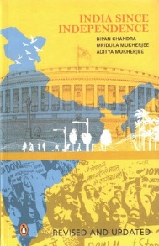
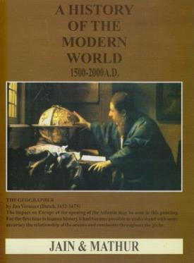
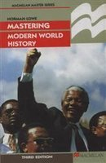
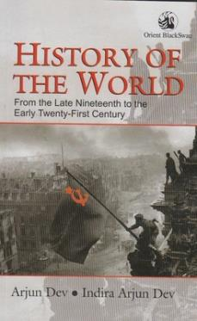
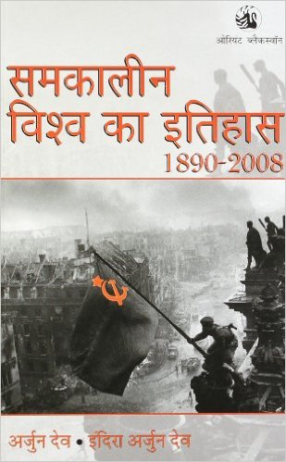
History : Mains GS1 (Post independence + world)
Bipan Chandra
Jain & Mathur
Norman Lowe
Old NCERT Arjun Dev
Click to buy
Book Edition
Kindle Edition
Cost benefit ▼
+ Mrunal.org/history
Notes:
Mains-2014 World History rather too easy.

Slide 31
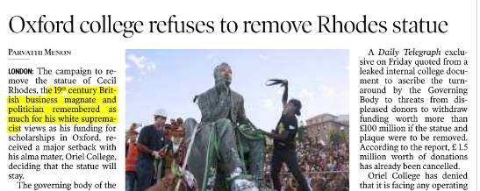
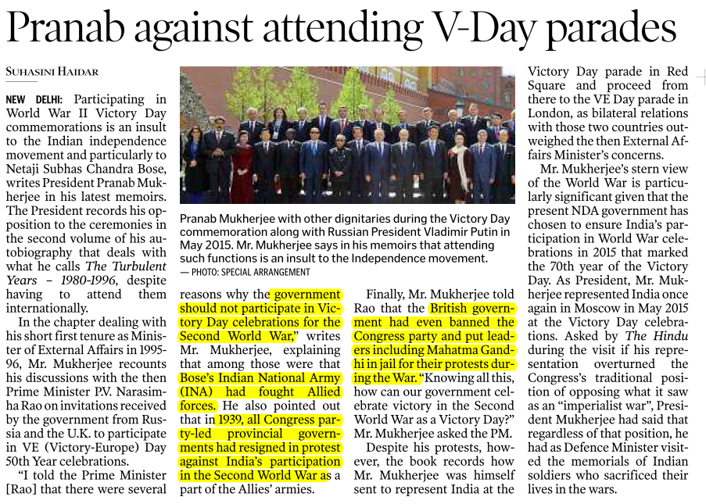
Hindu and World History

Slide 32
GS for a “Killer” doing PRELIMS-CUM-MAINS Prep.
GSM1,2,3
GSM1,2,3
GSM1,3
GSM1, 2, 3
GSM1,2
Economy
Science Tech
Current
History
Geography
Polity
Agriculture
Environment
Culture
IR/Defense
GSM1
GSM 2,3
GSM 1, 2, 3
Notes:
Killing is as easy as breathing.

Slide 33
Brief analysis of last 3 Prelim papers
preCSAT: PIN
Sports, PIN Easy to moderate
Pinch higher than NCERT
Lunacy gone. 2/3 solvable.
Freedom struggle getting bit tougher
Medieval making comeback
No current. Mostly Laxmikanth
Easy to moderate, mostly theory, contemporary
Crazy physical
Moderate to difficult but not IFoS-exclusive
Mostly map based, Moderate
Easy to moderate.
Nothing IFoS-exclusive

Slide 34
What type of MCQs are asked?
IR/Diplomacy
Amnesty intl.- what is it?
3- regional group- which of them India is member of?
Participants of a group? purpose of a group?
summits, name of declaration and theme?

Slide 35
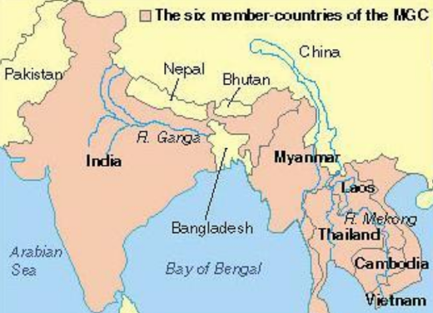
groupings
CSE-2015
14. In the Mekong-Ganga Cooperation, an initiative of six countries, which of the following is/are not a participant/ participants?
1. Bangladesh
2. Cambodia
3. China
4. Myanmar
5. Thailand
Answer
(a) 1 only (b) 2, 3 and 4 (c) 1 and 3 (d) 1, 2 and 5

Slide 36
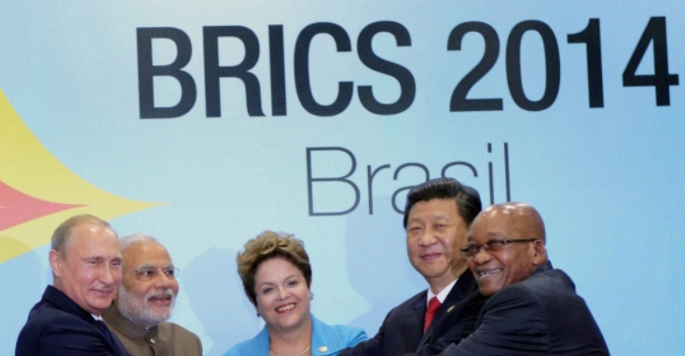
Meetings, summits, themes, declarations
CSE-2015
53. The 'Fortaleza Declaration', recently in the news, is related to the affairs of
(a) ASEAN
(b) BRICS
(c) OECD
(d) WTO
TheHindu 2014, Jul.
Why read Hindu “1 year” before prelims

Slide 37
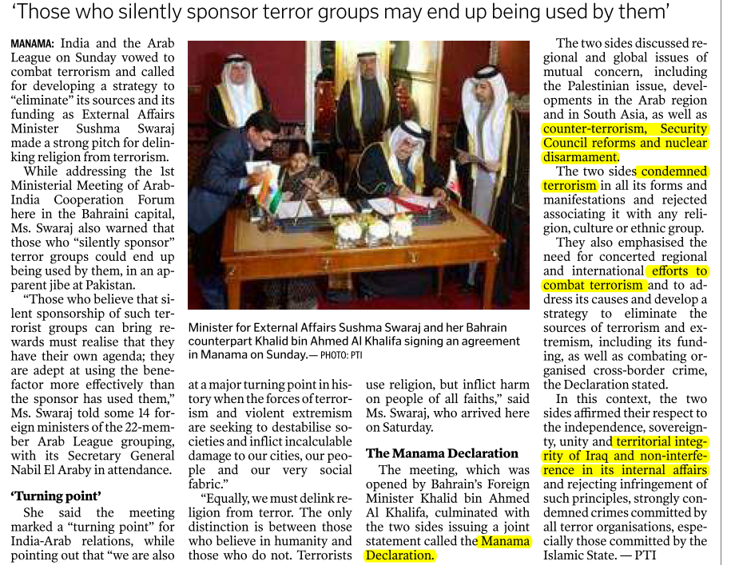

Hindu 2016 Jan: Manama Declaration

Slide 38
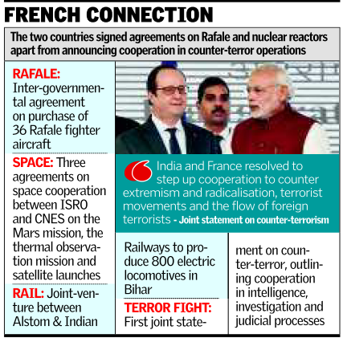
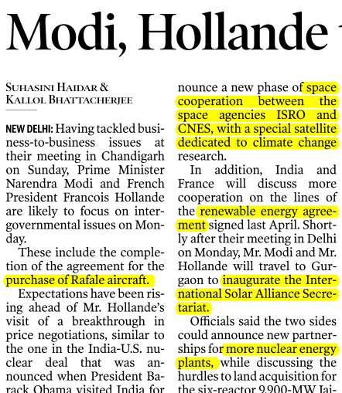
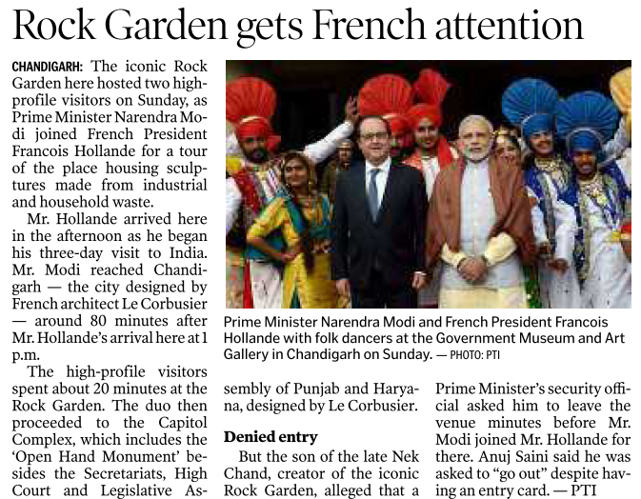

India France: Jan-16

Slide 39
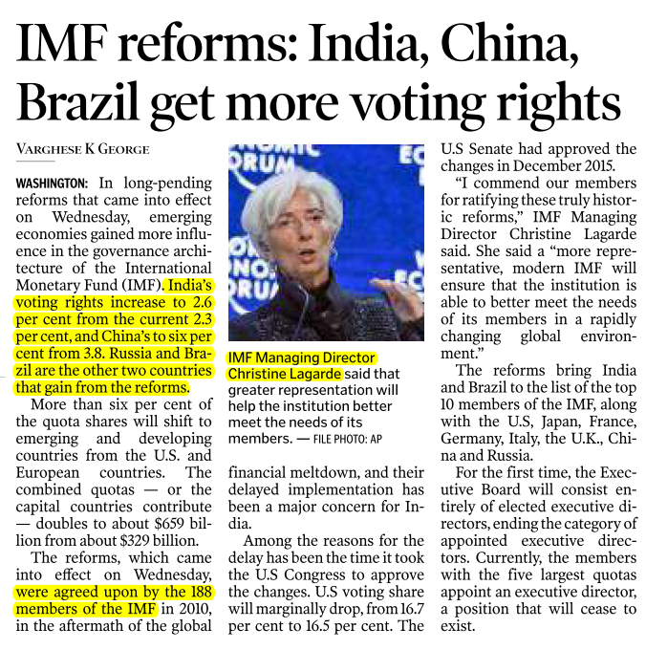
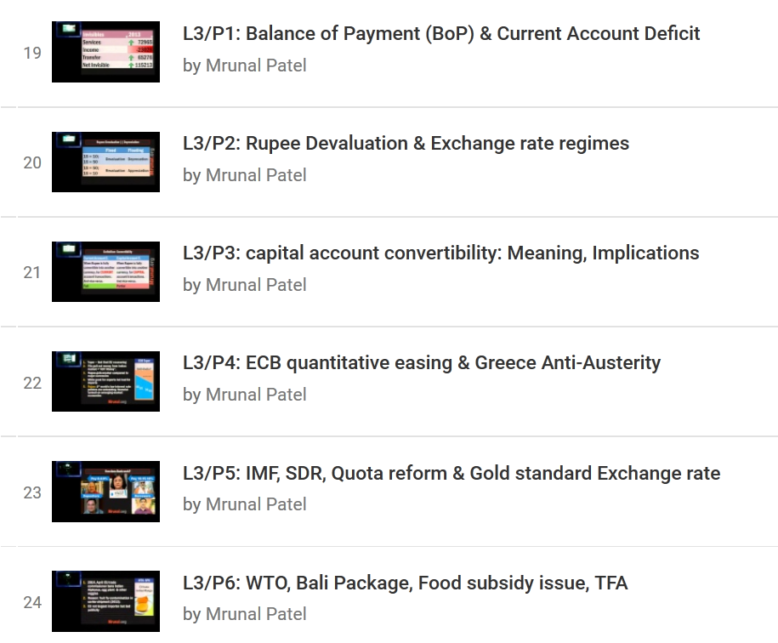
India IMF
Hindu Jan 2016
Backend theory
youtube.com/user/TheMrunalPatel

Slide 40
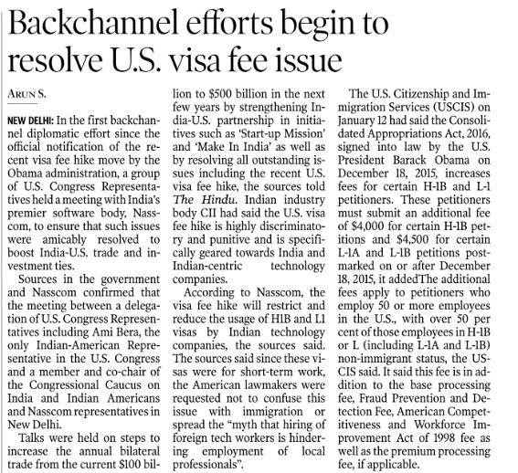
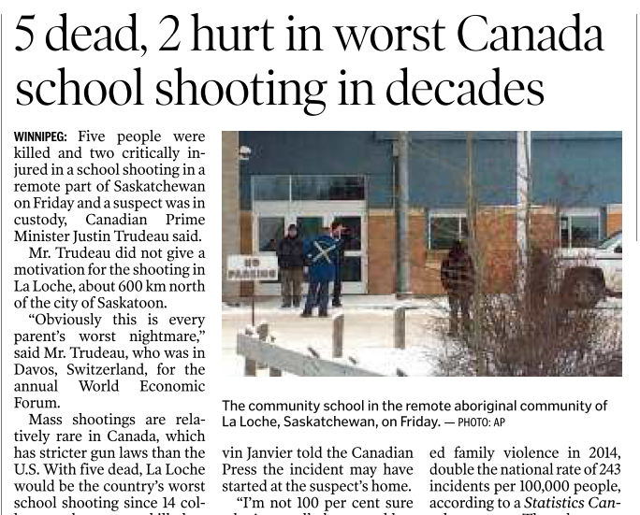
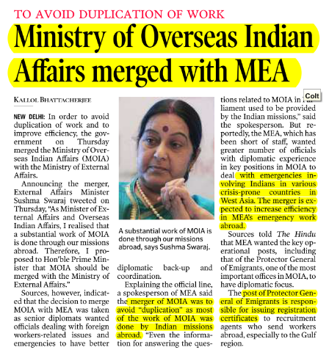
Affecting Diaspora
Limited edition of Pravasi Bharatiya Diwas

Slide 41
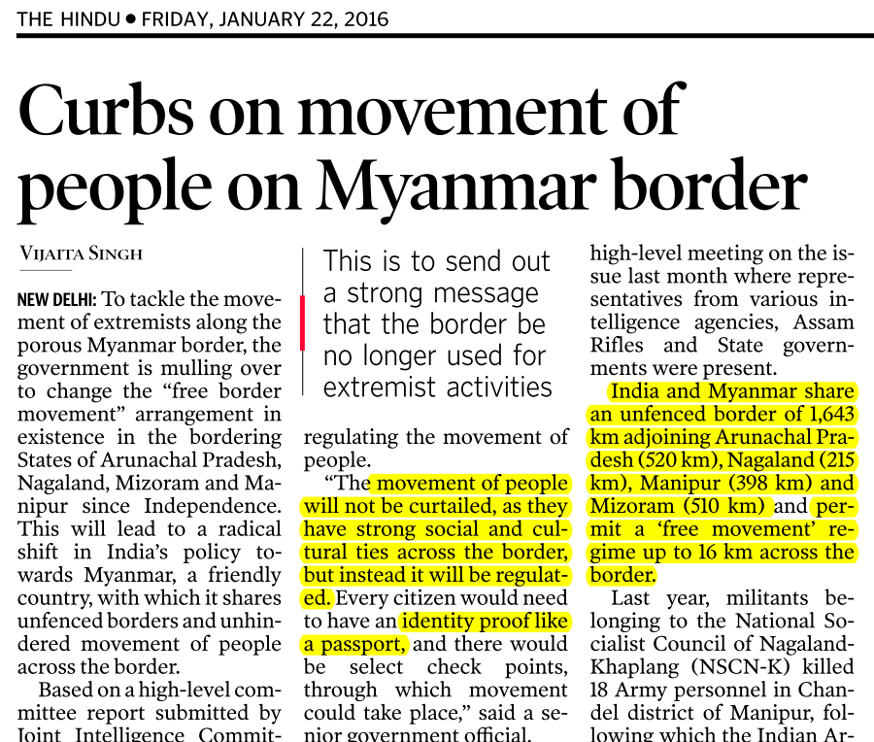
GS3: Border management
Notes:
Even if they ask a map based question.

Slide 42
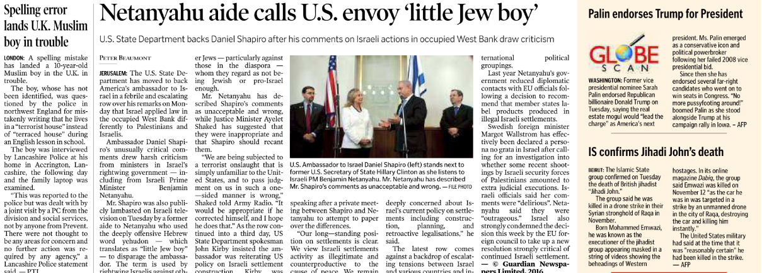
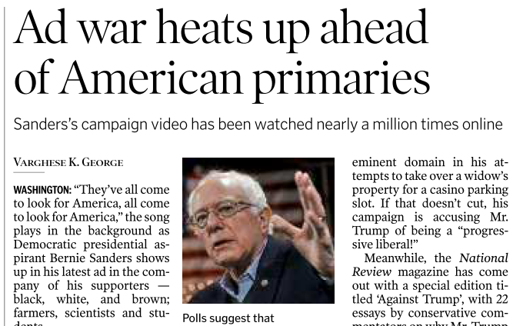
GSM2: only if it “Affects” Indian interests
Notes:
Ball by by US election not important.

Slide 43
diplomacy
Rajamohan (Indianexpress)
theHindu, Frontline
Idsa.in (without becoming think-tank)
IGNOU-MPSE-001: India and world

Slide 44
GS for a “Killer” doing PRELIMS-CUM-MAINS Prep.
GSM1,2,3
GSM1,2,3
GSM1,3
GSM1, 2, 3
GSM1,2
Economy
Science Tech
Current
History
Geography
Polity
Agriculture
Environment
Culture
IR/Defense
Finish these 1st
GSM1,2 (polity, IR)
GSM 2,3
GSM 1, 2, 3
Notes:
Killing is as easy as breathing.

Slide 45
Today’s Topics
Prelim cum Mains Preparation
7 days duty: How to read theHindu

